Slide 2

Back ground
数据安全的重要性
现在越来越多的安全需求，应用更广泛，document加密传递（between individuals, employees, companies）

Slide 3
What is Digital Certificate
举几个看得见的例子，电子银行，手机sim卡，https://, 电脑里安装的证书

Slide 4
Why is security needed on the Internet?
有哪些数据安全的问题，安全漏洞
怎么用digital certificate解决的

Slide 5
Types of digital certificate
TLS/SSL server certificate
How to keep your certificate
Use of TPM

Slide 6
The contents of a digital certificate (X.509 certificate
)
Most digital certificates in use today follow what is known as the X.509 standard. X.509 is used in SSL (Secure Sockets Layer) and TLS (Transport Layer Security)
it's what's being used in HTTPS, FTPS, WebDAVS and other secure data transfer protocols.
Information about the subject a.k.a. Subject Name - "subject" refers to the site represented by the cert.
Information about the certificate issuer/certificate authority (CA) - The CA is the body that issued and signed the certificate. More about this shortly
Serial number - this is the serial number assigned by the issuer to this certificate. Each issuer must make sure each certificate it issues has a unique serial number.
Version - the X.509 version used by a given certificate. These days, you'll usually find version 3.
Validity period - certs aren't meant to last forever. The validity period defines the period over which the cert can still be deemed trustworthy.
Signature - This is the digital signature of the entire digital certificate, generated using the certificate issuer's private key
Signature algorithm - The cryptographic signature algorithm used to generate the digital signature (e.g. SHA-1 with RSA Encryption)
Public key information - Information about the subject's public key. This includes:
the algorithm (e.g. Elliptic Curve Public Key),
the key size (e.g. 256 bits),
the key usage (e.g. can encrypt, verify, derive), and
the public key itself

Slide 7
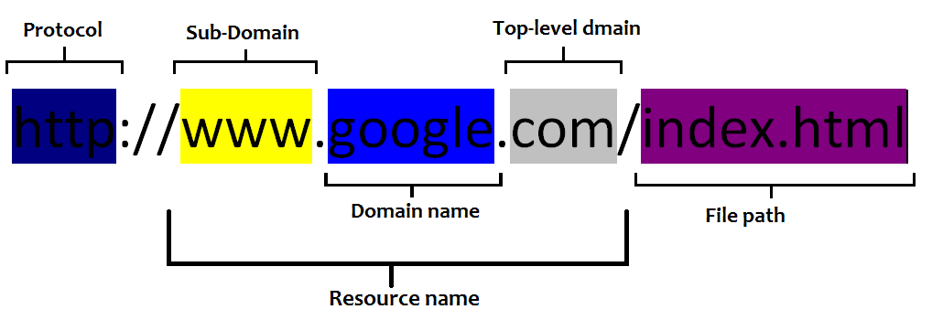
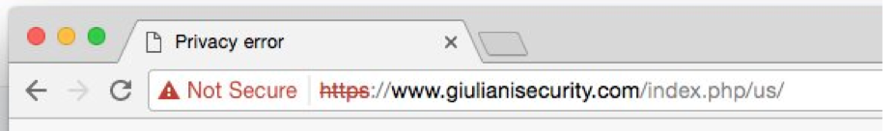
How to know if a website is trustworthy?

Slide 8
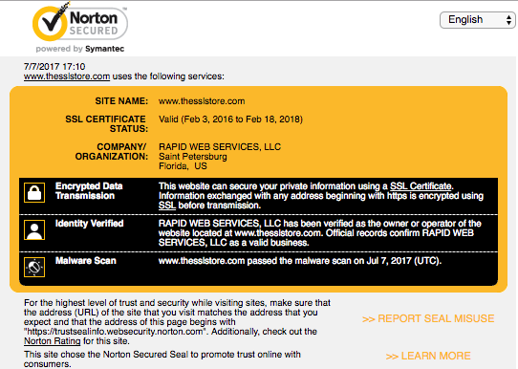
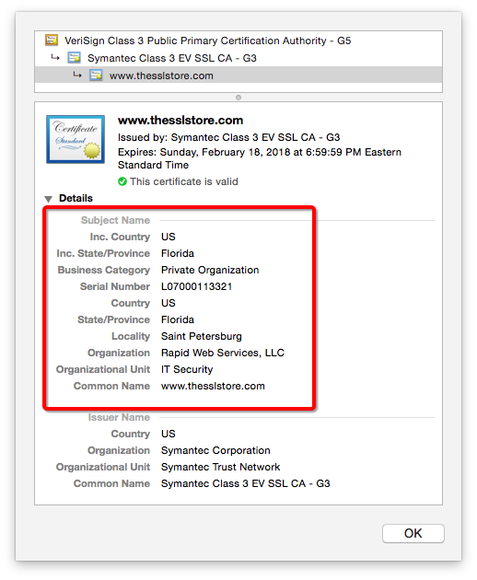
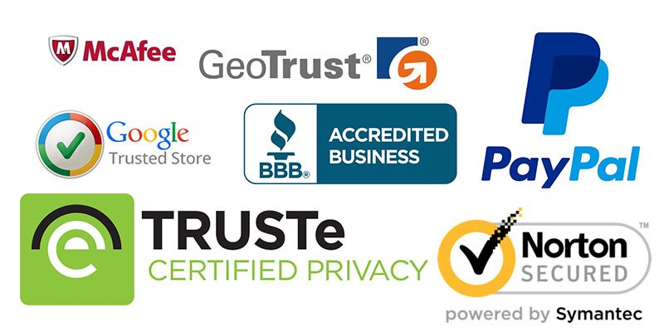

Slide 9
TPM
How they recognise that is you?
How to keep your certificate
Use of TPM

Slide 10
How to create a digital certificate?

Slide 11
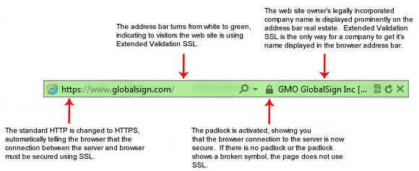
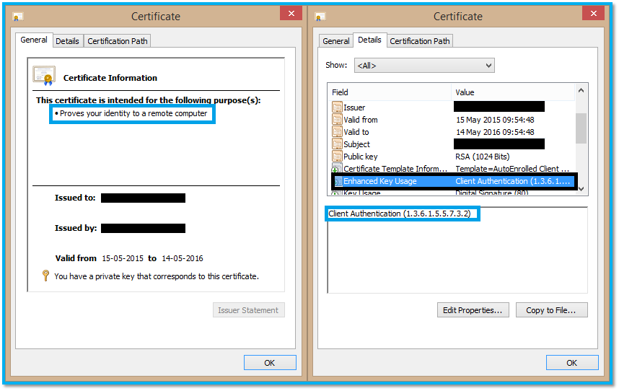
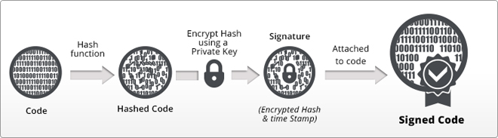
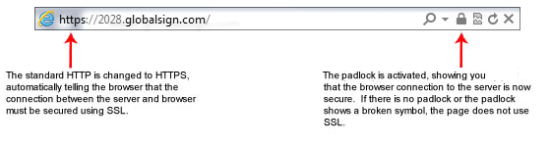
how does digital certificate work？
How did Code Signing Certificate works
What Client Certificate looks like
How SSL working in HTTPS

Slide 12
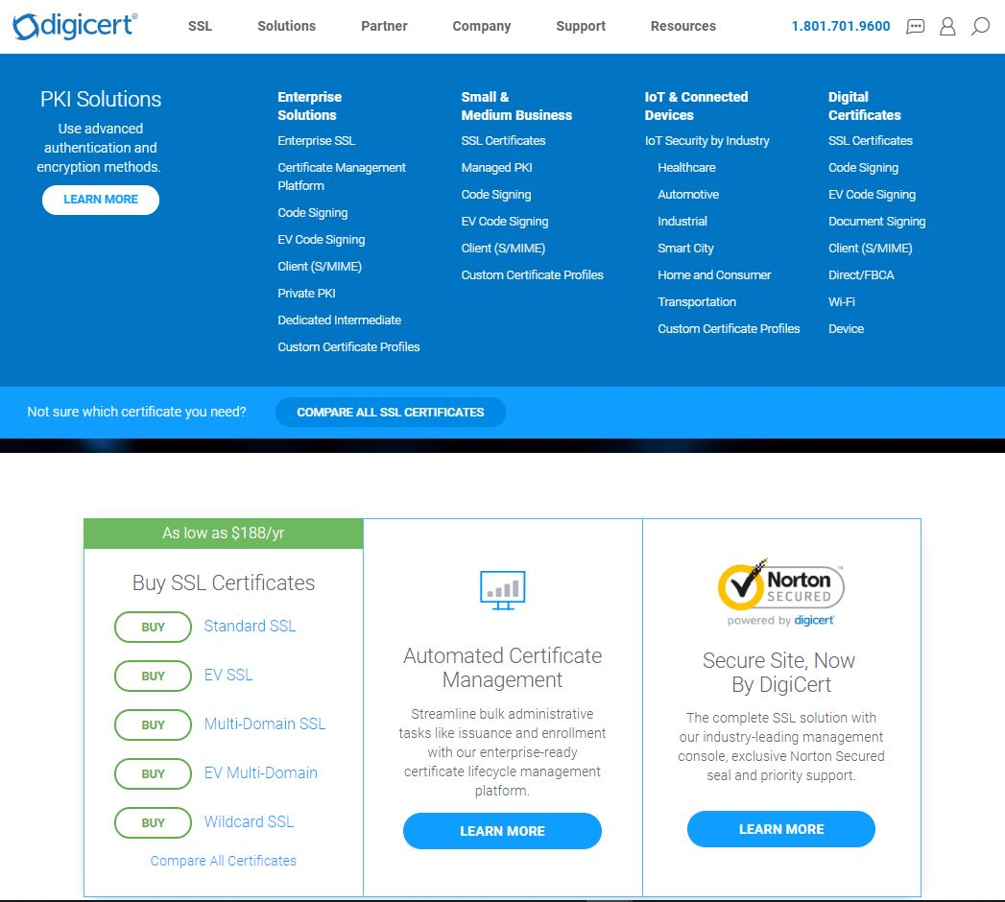
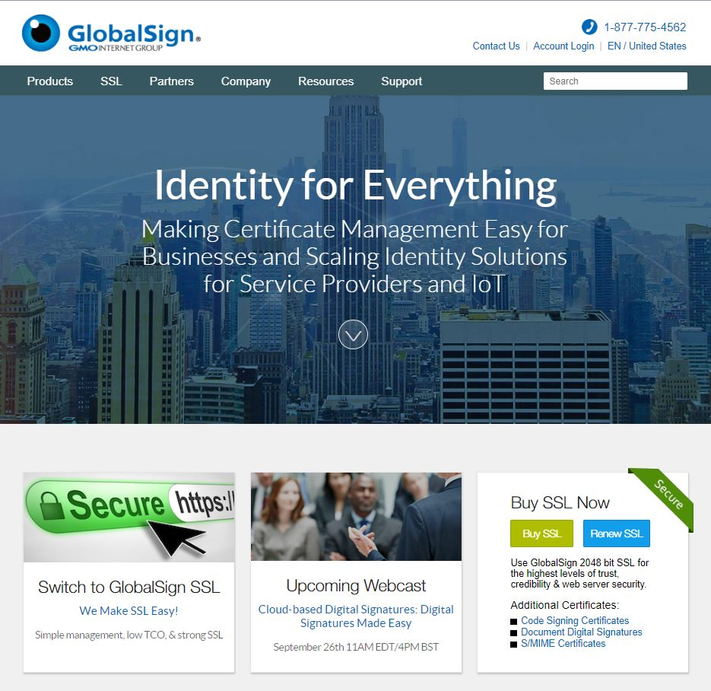
CA agent

Slide 13
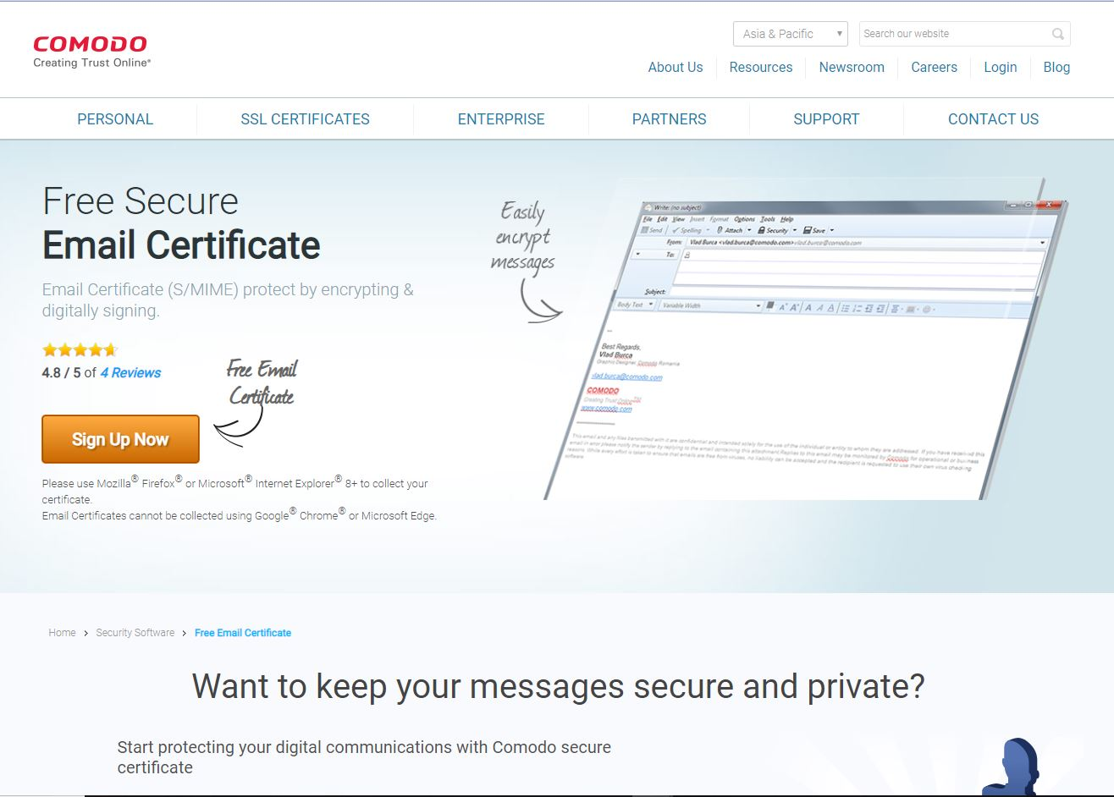
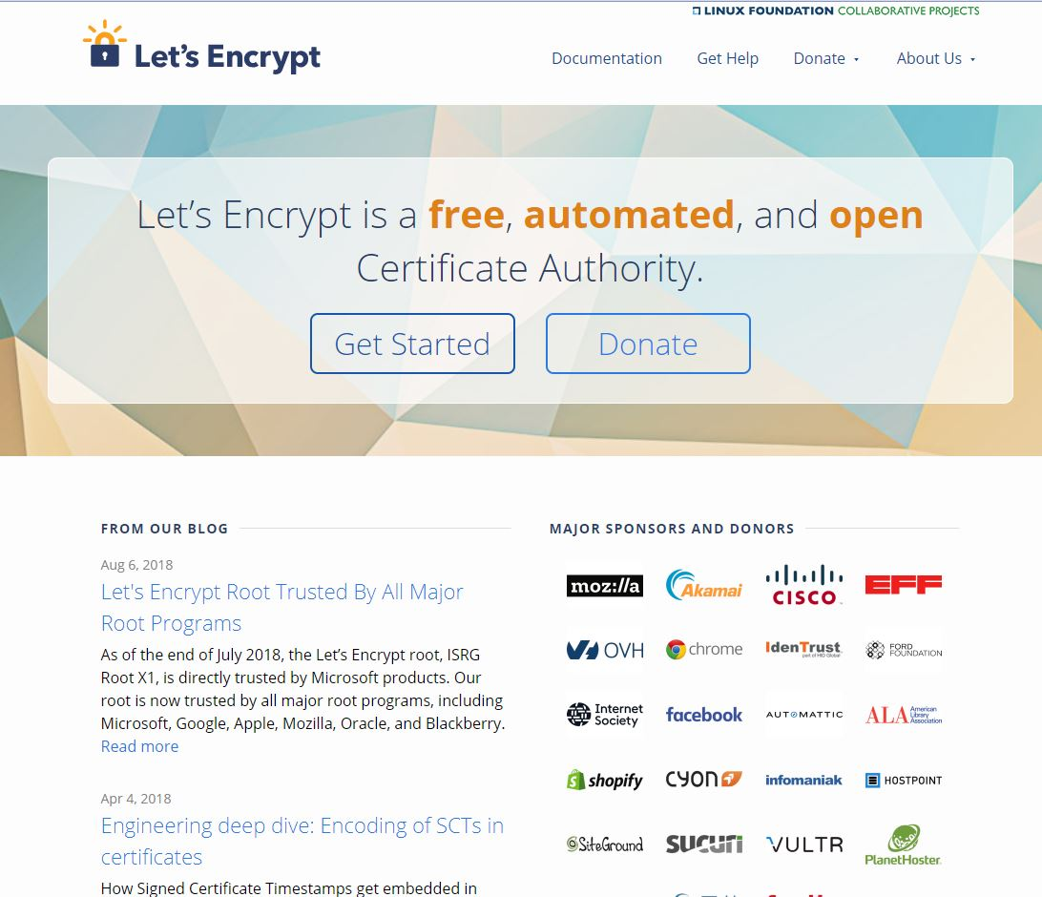
Free agent
Let’s see how to create a free digital certificate（ClickMe）

Slide 14
Challenge of digital certificate（fake digital certificate）
一些假digital certificate的列子，截图

Slide 15
How to defend fake certificate？

